Slide 1

DOM Manipulation
By Alex Joslin

Slide 2
Document Object Model (DOM)
An object containing the HTML code and other properties of a web page and allows JavaScript to interact with it.
It is created automatically by the browser whenever you load a new page.

Slide 3
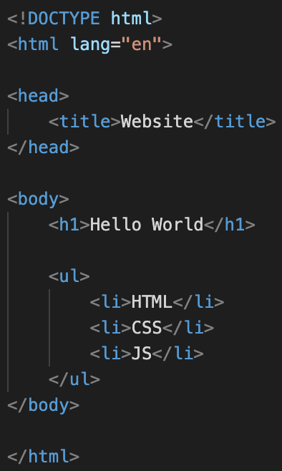
DOM Structure
Document
html
head
Body
title
h1
ul
li
li
li
html + css
console.dir(document)

Slide 4
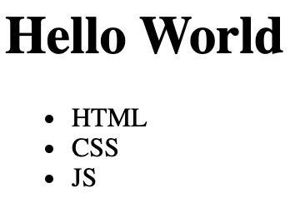

Slide 5
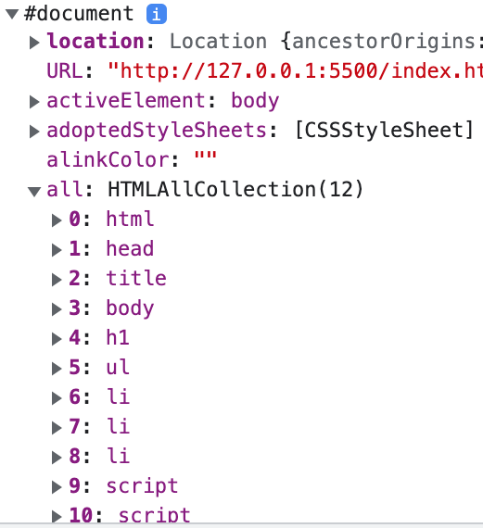
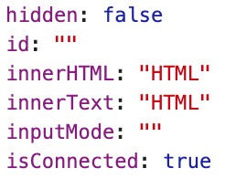
Document
html
head
Body
title
h1
ul
li
li
li

Slide 6
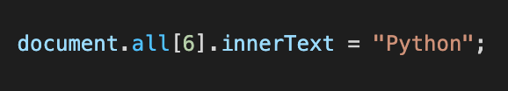
Document
html
head
Body
title
h1
ul
li
li
li

Slide 7
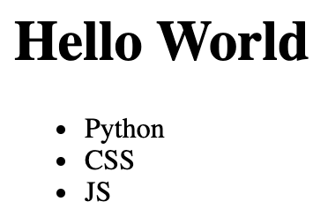
Document
html
head
Body
title
h1
ul
li
li
li

